Slide 1

AI Resume Analyzer
Automatically Match Resumes to Jobs Using AI

Slide 2
AI Resume Analyzer
GROUP MEMBERS:
Rumaz Naveed Qureshi -52
Muhammad Hanzala -82
Hanzala Wahid - 106
Zaid Rajput -109

Slide 3
Introduction
What’s the Problem?
Companies get 100s of resumes for one job.
Manual screening is slow and biased make human efforts
How Our Project Helps:
Uses AI to scan resumes and rank them instantly.
Saves time, reduces human errors.

Slide 4

Why Traditional Methods Fail
Human Bias: Recruiters favor familiar names/schools.
Time Waste: 75% of resumes are unqualified (LinkedIn data).
Inconsistency: Different recruiters pick different candidates

Slide 5



How it works ???
A
C
Input: Resumes (PDF/Word) + Job Description.
AI Processing:
Output: Scores resumes (e.g., "83% match")
Extracts text (skills, experience).
Compares resumes to the job using keyword matching.
B

Slide 6



How it works (in tech )??
A
B
C
Input: Resumes (PDF/Word) + Job Description.(same)
Processing:
Output: Match percentage and ranked list.
Text Extraction: PyPDF2, docx2txt.
NLP: spaCy for keyword/entity extraction (skills, education).
Matching: Cosine similarity (TF-IDF vectors)

Slide 7
Tech Stack
NLTK/Spacy: For understanding resume text.
Python: Main programming language.
Streamlit: For UI frontend & backend intergration
spaCy (NLP)
scikit-learn (TF-IDF, cosine similarity).
Database Connection: Custom resume dataset (MySql)

Slide 8

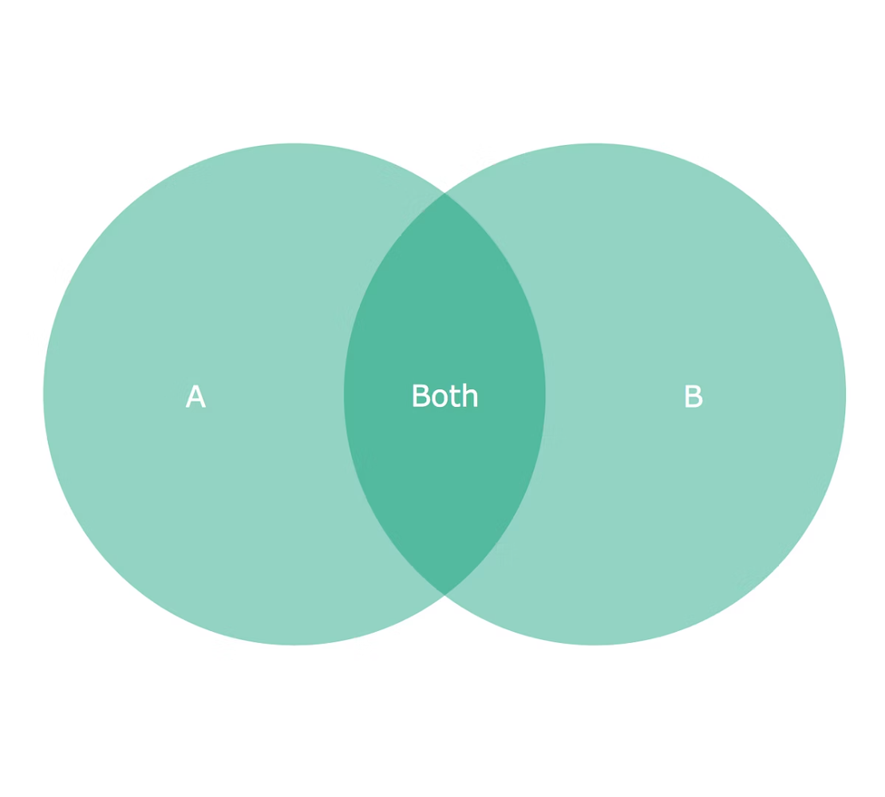
What is Cosine Similarity?
Simple Definition: Measures how similar two documents (resume vs. job) are.
Example:
Job: "Python, NLP, Data Analysis"
Resume: "Python, Machine Learning" → 70% match.

Slide 9
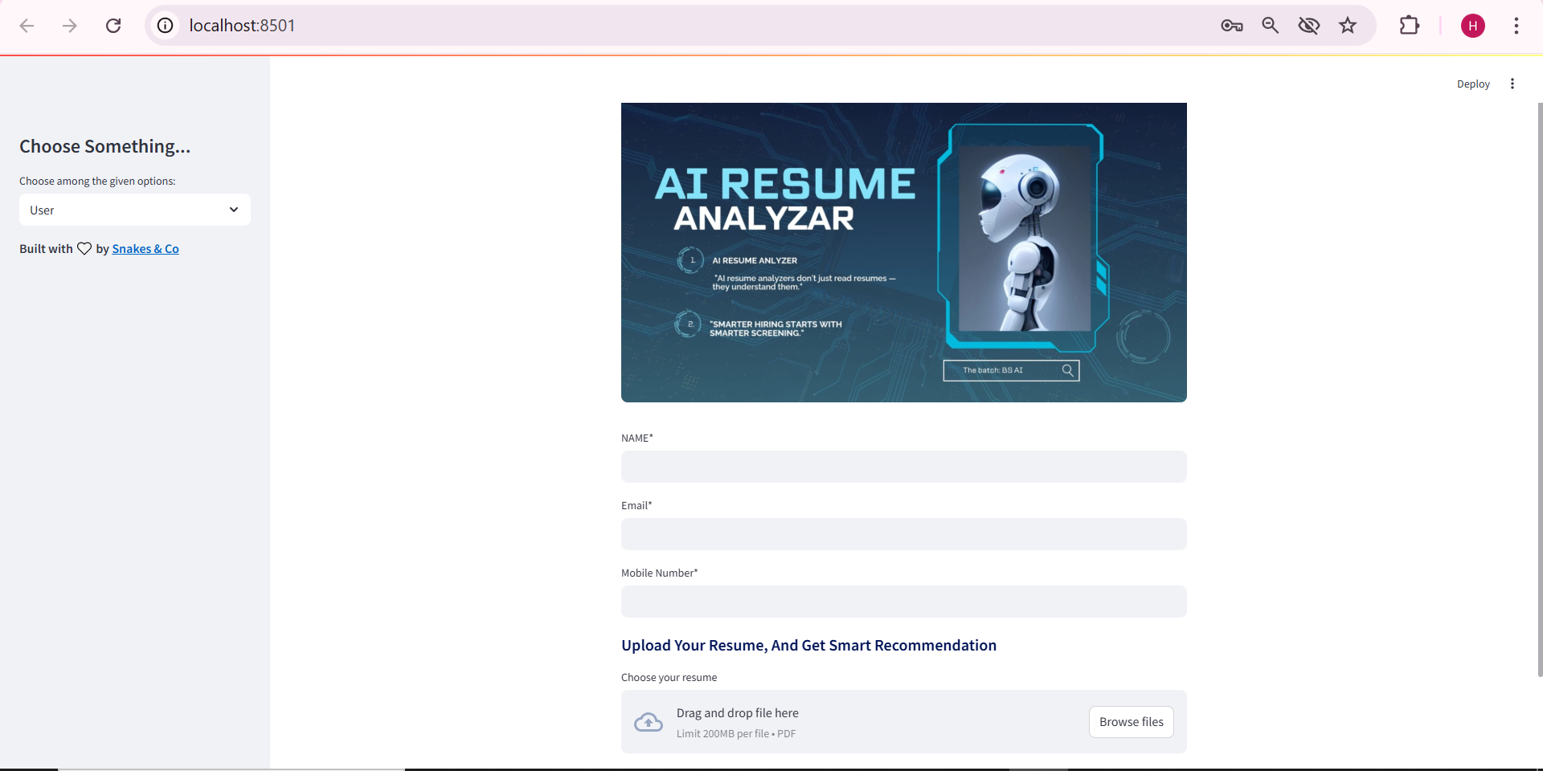
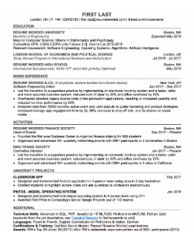
Demo Screenshot
Visual: Our Streamlit app screenshot.
"Upload resumes → Get ranked results in seconds!

Slide 10
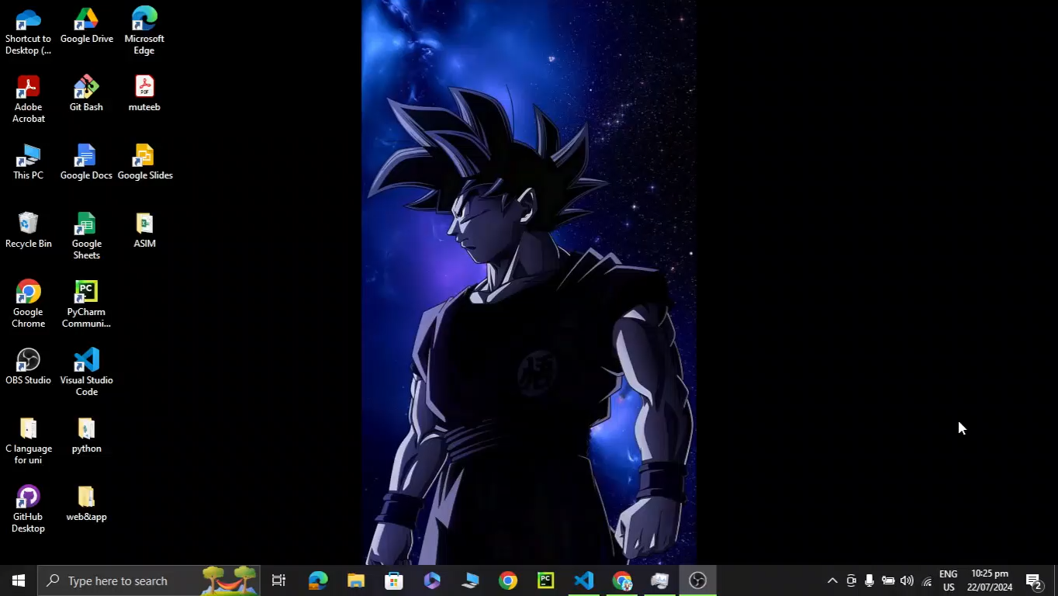
Project Simulation

Slide 11
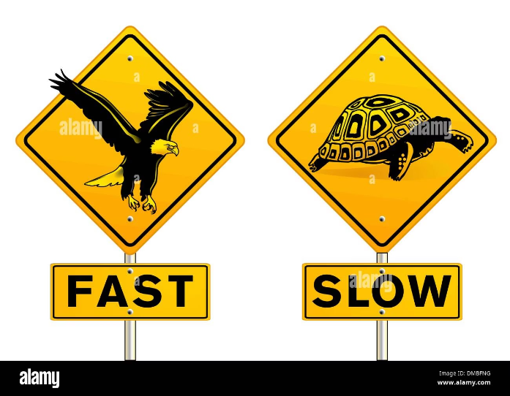
Advantages Over Manual Screening
-> Speed: 1 minute vs. 1 hour for 100 resumes.
-> Fairness: No bias based on names/gender.
-> 24/7: Works anytime

Slide 12
Limitation
Format Issues: Fancy resumes with images/tables may not parse well.

Slide 13


Future Work
Add more job categories (e.g., Marketing, Finance, pharmaceutical, Industrial ).
Improve UI with drag-and-drop uploads
Multi-Language: (Russian, Arabic, Spanish,,French,German) support.
Skill Trends: Show trending skills (e.g., "More jobs are trending in Agenting AI")
.

Slide 14
Refrences
https://github.com/deepakpadhi986/AI-Resume-Analyzer/tree/main
https://abhivruddhi.mituniversity.ac.in/wp-content/uploads/2023/08/Resume-Builder-.pdf
in/deepakpadhi986
https://leetcode.com/u/8oqI6e2ORX/
https://dnoobnerd.netlify.app

Slide 15

END!

Slide 16

From us!
Taking good bye with this project, see you with soon with an exiting AI idea.

